Slide 1
Columbia College Communications Overview
WeConnect Presentation
Thursday, 22 Feb 2024
Roswell Mueller Director of Strategic Communications Columbia College, Office of the Dean

Slide 2
Overview
Our Mission
CME² Structure
Audiences, Channels, Tools
Execution & Ethos
Case Study
Crisis Comms
Questions & Discussion

Slide 3
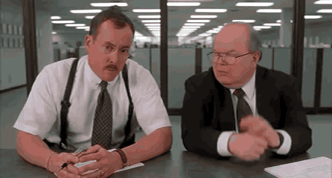
Our Mission
The Communications, Marketing, Editorial and Events (CME²) team supports the Columbia College mission through clear, timely communications, rich storytelling and building opportunities to connect and celebrate the College’s diverse constituencies: students, alumni, faculty and staff.
We aim to facilitate and enhance the student experience; foster alumni pride and connection; promote the College’s values and priorities; and strengthen a sense of community for all.

Slide 4
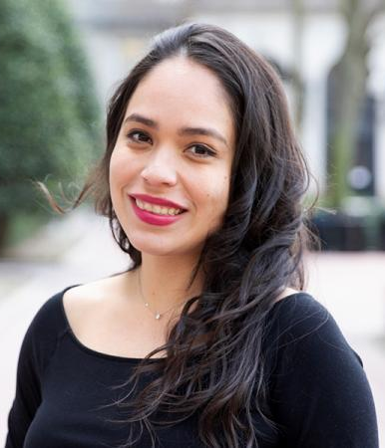
OUR MISSION
CME² Team Structure
Ross Mueller Communications & Marketing
Campus & Alumni Communications
Web & Digital Platforms
Public Affairs, Exec & Crisis Comms
Alexis Boncy Editorial
Columbia College Today
Content Strategy & Execution / Social
Graphics & Media Production
Jackie Rivera Events & Special Projects
Class Day, Convocation
Reunion, Homecoming
Signature Events (Hamilton, John Jay)
WeConnect – Columbia College Communications Overview

Slide 5
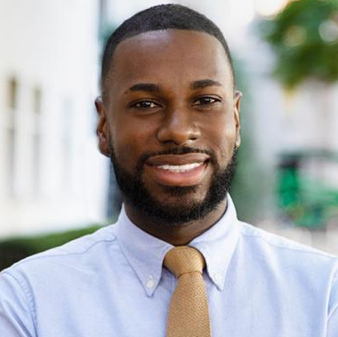
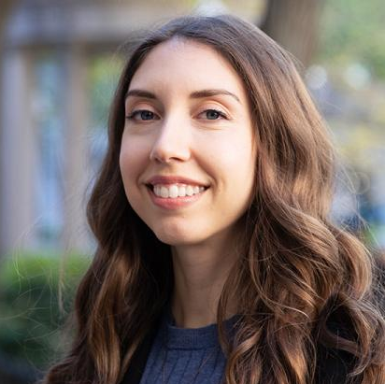
OUR MISSION
Communications & Marketing Team
Dream Team!
Jack Fitzpatrick
Assoc. Dir. Campus Comms
Aimee Lam
Asst. Dir.
Campus Comms
Byron McCray
Assoc. Dir. Alumni Mktng.
Christine Mallon
Asst. Dir. Digital Comms
WeConnect – Columbia College Communications Overview

Slide 6
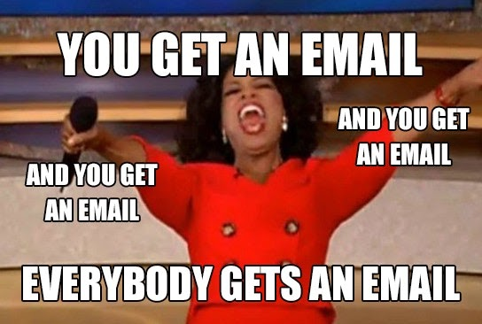
Audiences, Channels & Tools
College / Engineering Students & Families
Columbia College Alumni
Project Management Asana
CC/CC-SEAS/Alumni Drupal Websites
Brand & Asset Management
Social Media
Salesforce Marketing Cloud
Email Messaging
Team Files & Protocols
University/Partner Channels

Slide 7
AUDIENCES, CHANNELS & TOOLS
What is the Work?
Fall Term
Spring Term
Summer
CC/EN Student Newsletters – 2x Weekly – Monday/Friday
Campus Comms
Dean’s Office / Partner Comms – Recurring
Countdown to Class Day
Countdown to Columbia
Public Affairs & Crisis Comms
Alumni Marketing
Reunion
New Alumni Onboarding
Homecoming
Hamilton
John Jay
CCAA Newsletters & Community Messaging – Monthly & Recurring
WeConnect – Columbia College Communications Overview

Slide 8
AUDIENCES, CHANNELS & TOOLS
Where Does the Content Come From?
Timely Content
All partner content accommodated where possible.
Weekly Digest
Dean’s Office
Curricular
Friday Rundown
Co-Curricular
Partner Offices
Enduring Content
‘Column inches’ distributed amongst partners as needed.
Annual Campaigns
Extra Curricular
Stand-Alone Messages
WeConnect – Columbia College Communications Overview

Slide 9
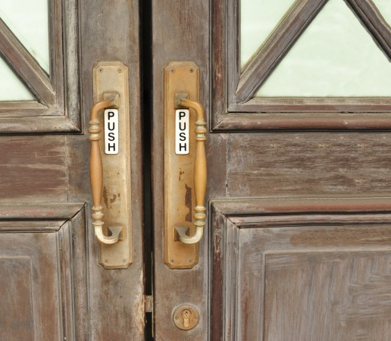
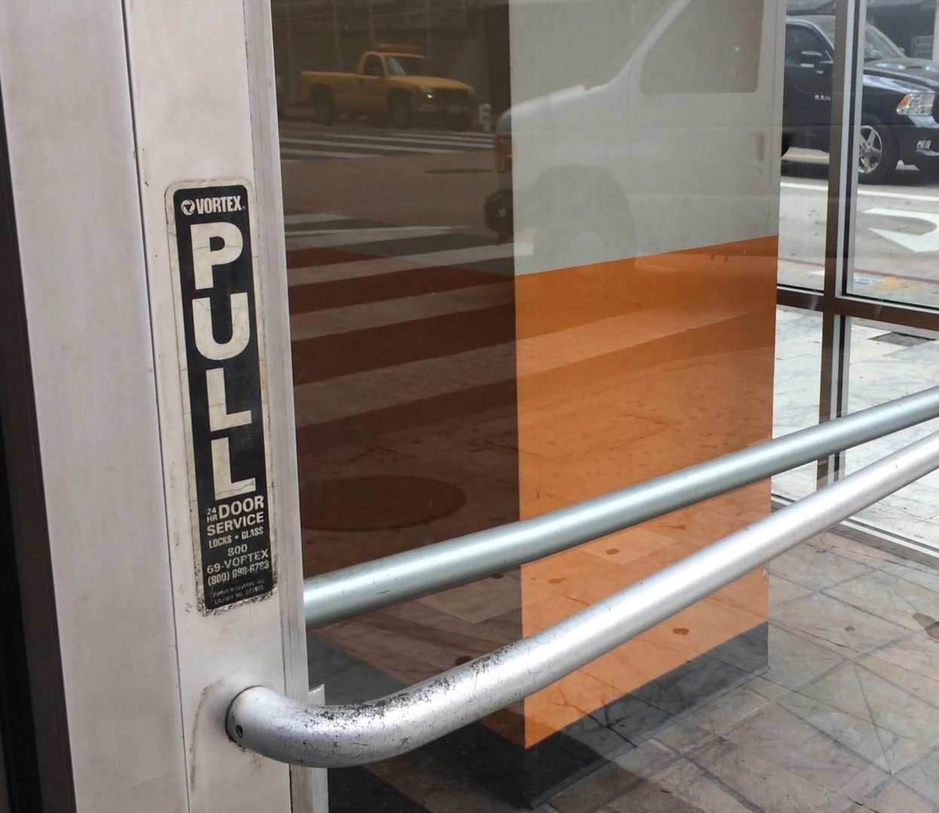
Execution & Ethos
Noorman Doors
Anything this simple needing instructions is a design failure.

Slide 10
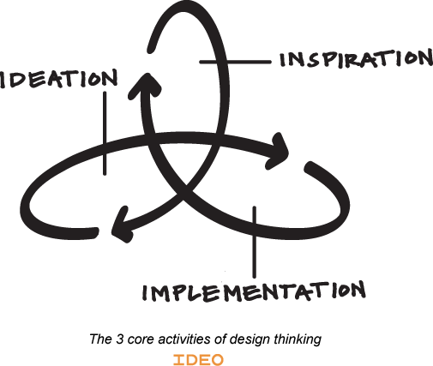
EXECUTION & ETHOS
Design Thinking
WeConnect – Columbia College Communications Overview

Slide 11
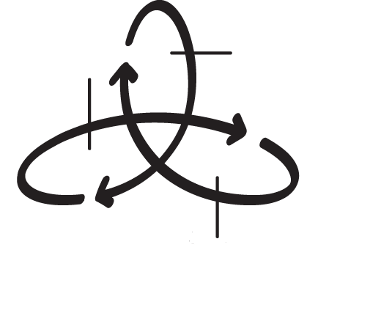
EXECUTION & ETHOS
Grounding the Strategy
Who is the audience?
Who delivers the message?
What do we want them to do?
WeConnect – Columbia College Communications Overview

Slide 12
EXECUTION & ETHOS
Framing the Message
Macro Frame
Sender / Audience
Mezzo Frame
Message Context
Micro Frame
Tone / Style / Voice
WeConnect – Columbia College Communications Overview

Slide 13
EXECUTION & ETHOS
Case Study
WeConnect – Columbia College Communications Overview

Slide 14
COUNTDOWN CASE STUDY
Audiences & Content Buckets
CC + SEAS Students
Parents + Families
First Year
Transfer
Combined Plan
Visiting
Exchange
Critical Information – Deadlines, checklists
What Applies to Everyone?
General Information – Offices, Services, etc.
What Applies to Some?
Logistics – Housing, Dining, CUIT, Events
Compliance – Health, IDs, Housing, Pre-Arrival
What Needs Reinforcing?
Community – Student Voices, Campus Life, FAQs
WeConnect – Columbia College Communications Overview

Slide 15
COUNTDOWN CASE STUDY
Targeting Via Content Tiers
TIER
1
All Students
Crosses schools, categories and affinity groups.
TIER
2
Targeted
Info for specific audiences: school, affinity, or category.
TIER
3
Self-Selecting
Brief, focused, enduring content designed to reinforce key info.
Live Webinars
Welcoming & Informative
Timed w/ schedule of weekly requirements
Pre-Recorded + Live Q&A
Informative & In-depth
Paired w/ Tier 1 schedule
Enduring (2 years min)
Pre-Recorded
No Set Schedule
Broad OR Targeted
Enduring (2 years min)
WeConnect – Columbia College Communications Overview

Slide 16
COUNTDOWN CASE STUDY
Straw-man Content Schedule
Week | Tier 1 | Tier 2 | Tier 3
1 | Welcome / Life as a CU Student | Fin Aid / FLI@CU / Intnl@CU | Bill Pay / Authorized Payer /etc.
2 | Columbia Health | CPS / Disability / TBD | Immunization / Insurance / etc.
3 | Academics at Columbia (CC/SEAS) | Faculty / Time Management | Bulletin / LitHum Intro / etc.
4 | Advising | Resources / Programs / Cohorts | Registration / Vergil / SSOL
5 | Life on Campus (Dining/Services) | ResHall Breakouts / Mail / Intnl@CU | Dining Halls / Housing Reference
6 | Move-In (Split Audience) | ——— | Convocation / Family Orientation
7 | Co-Curricular Info (Shared Message) | ——— | ———
WeConnect – Columbia College Communications Overview

Slide 17
COUNTDOWN CASE STUDY
Content Production Timeline
MARCH
APRIL
MAY
JUNE
JULY
AUGUST
TIER
1
Content Development
Draft Slides Due
MAY 1
Final Slides Due JUNE 1
Deploy Weekly
Friday AMs
TIER
2
Content Development
Final Slides
APRIL 15
Recording Deadline
MAY 15
Post Production Deadline
JUNE 30
Deploy Weekly
Tuesday AMs
TIER
3
Content Development
Final Slides
APRIL 30
Recording Deadline
MAY 31
Post Production Deadline
JUNE 30
Batch Deployment
Rolling
WeConnect – Columbia College Communications Overview

Slide 18
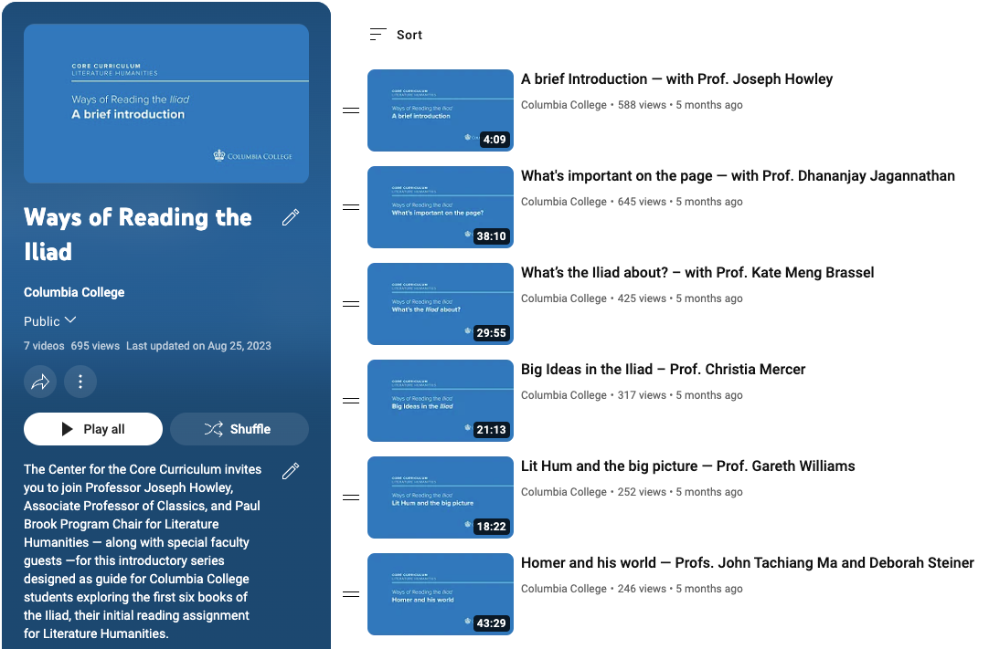
COUNTDOWN CASE STUDY
Tier 3 Example LitHum: Ways of Reading the Iliad
WeConnect – Columbia College Communications Overview

Slide 19
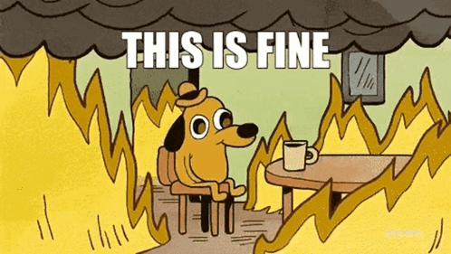
Crisis Comms
Everyone Else / Silent Majority
Involved / Impacted / Intense

Slide 20
Questions & Discussion

